Slide 1
Time and Frequency Report
Laboratorio Metrológico de Variables Eléctricas
(LMVE)
Instituto Costarricense de Electricidad
Costa Rica
Oscar Fallas Cordero
October 2017,
2015

Slide 2

Laboratory’s Development

Slide 3
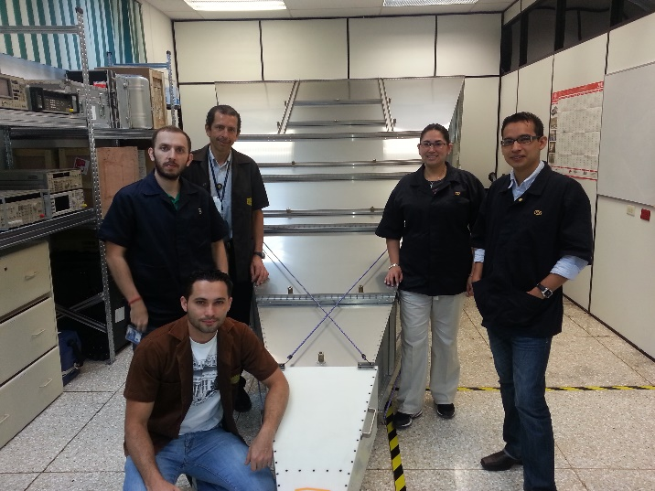
Laboratory Staff
Oscar Fallas Cordero, Electrical Engineer since 2009. T&F Metrologist.
Eng. Fallas is also Head of Laboratory.
Three metrologist working in EM field and a Quality Manager

Slide 4
Assessments and Training
J.M Lopez from CENAM, November 2010
F. Jiménez from CENAM, June and November 2014
R. Solís from CENAMEP, October 2014 & 2016
Remote cooperation through SIMTF e-mail
SIM TN participation

Slide 5
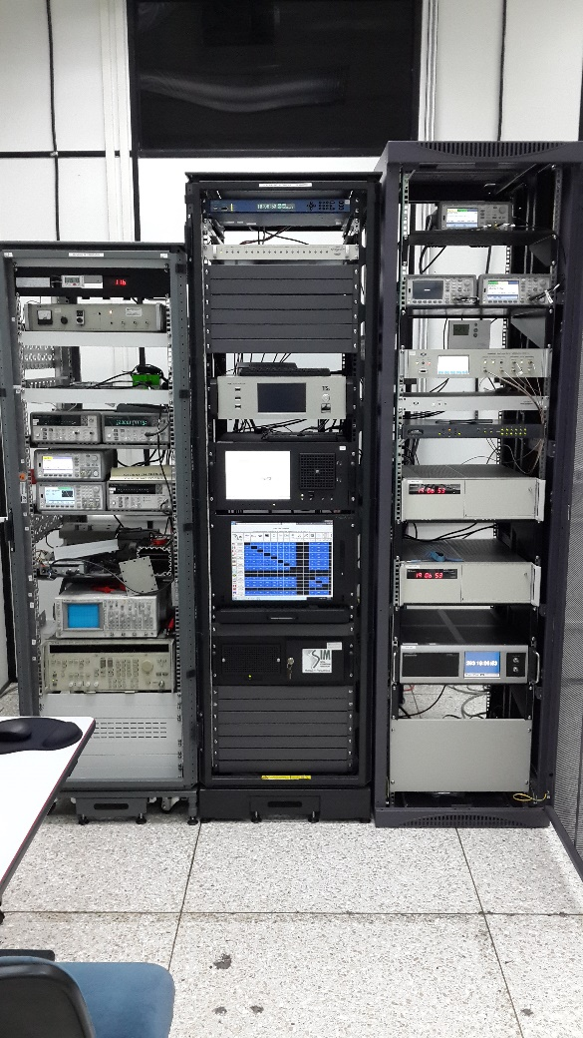
Structure
Traceability, Distribution and Dissemination
(Comparison System, switch and distribution amplifiers, NTP servers)
UTC(ICE), SIMT(ICE) (Standards, HROG)
Calibration Service
(frequency counters and generator, stopwatches cal system, check standars and oscilloscope)

Slide 7
CMCs

Slide 8
CMCs

Slide 9
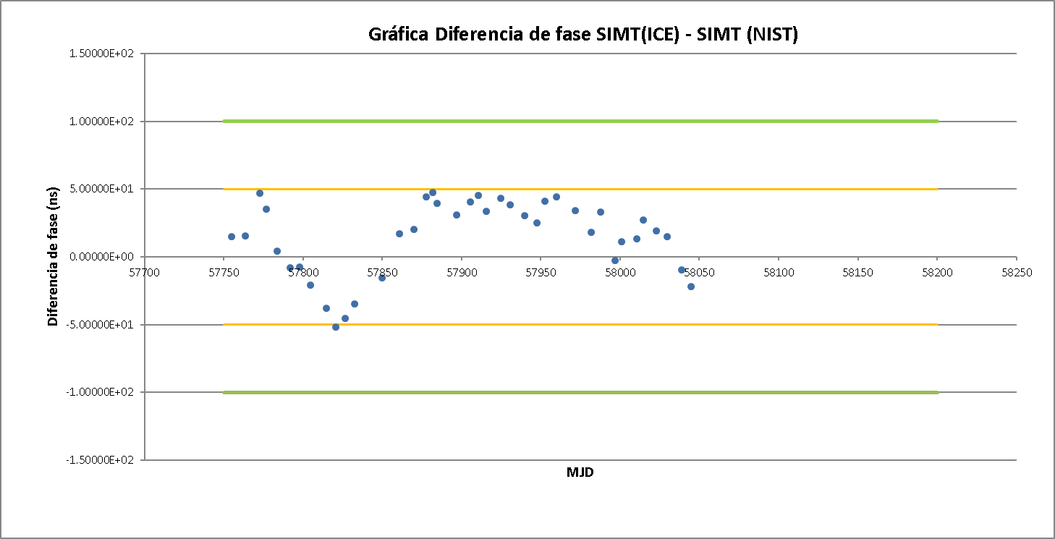
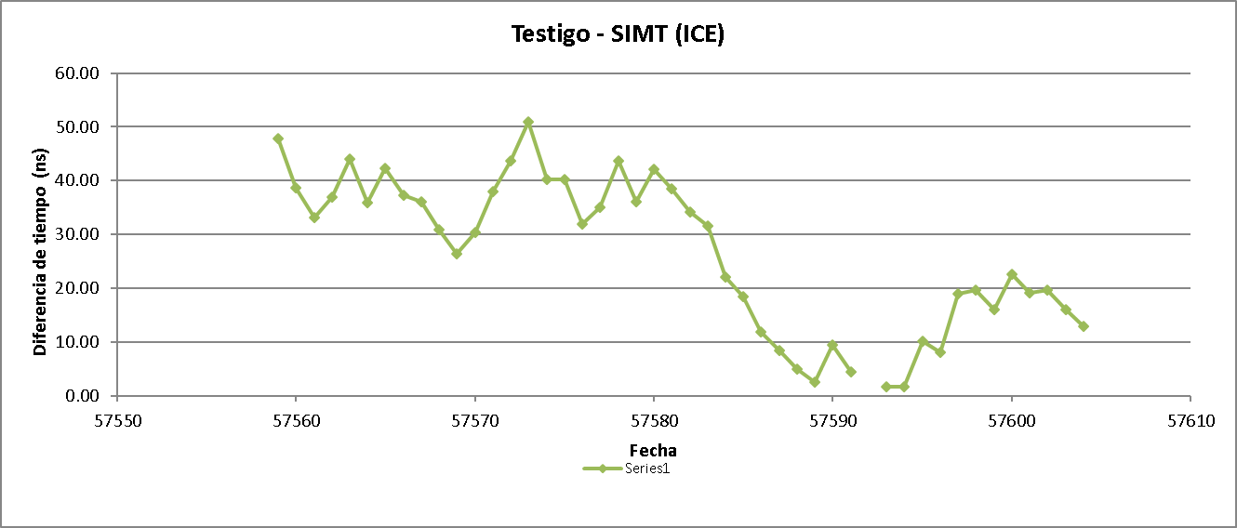
Quality Control

Slide 10
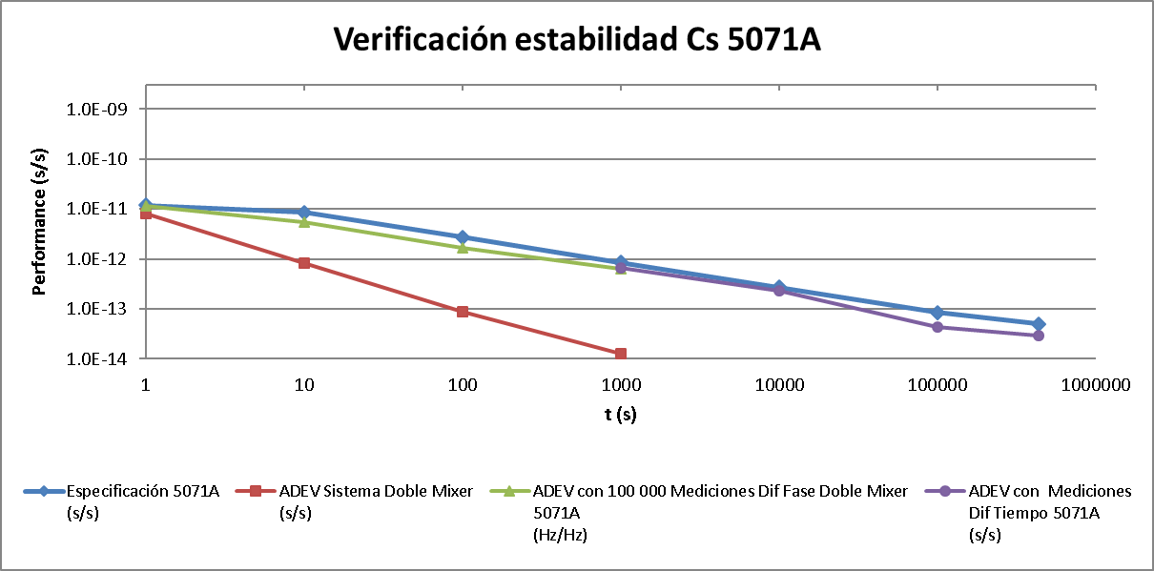
Quality Control

Slide 11
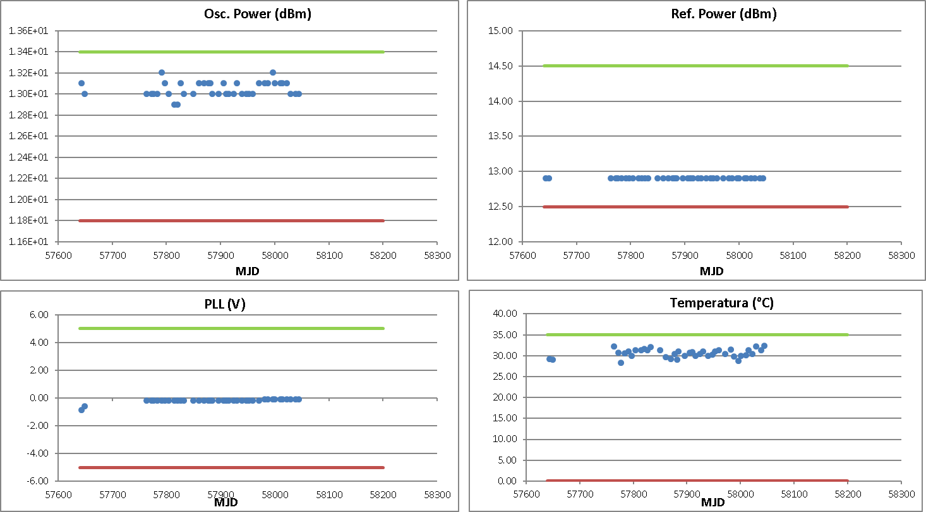
Quality Control

Slide 12
Achieves
National Calibration Services
Knowledge Transfer
  National T&F training
  National Stopwatches Comparison
NTP Service
  Web clock
  Voice clock
CMCs Publication
Contribution to UTC and tai
TCH Method for long and short term QS

Slide 13
Future Activities and Services
Low Frequency Services
NTP Service Improvement
  Equipment
  Alarm´s management
Complete Local comparison for QS
  Phase comparator
  Automatized System
Internship for T&F Lab improvement

Slide 14
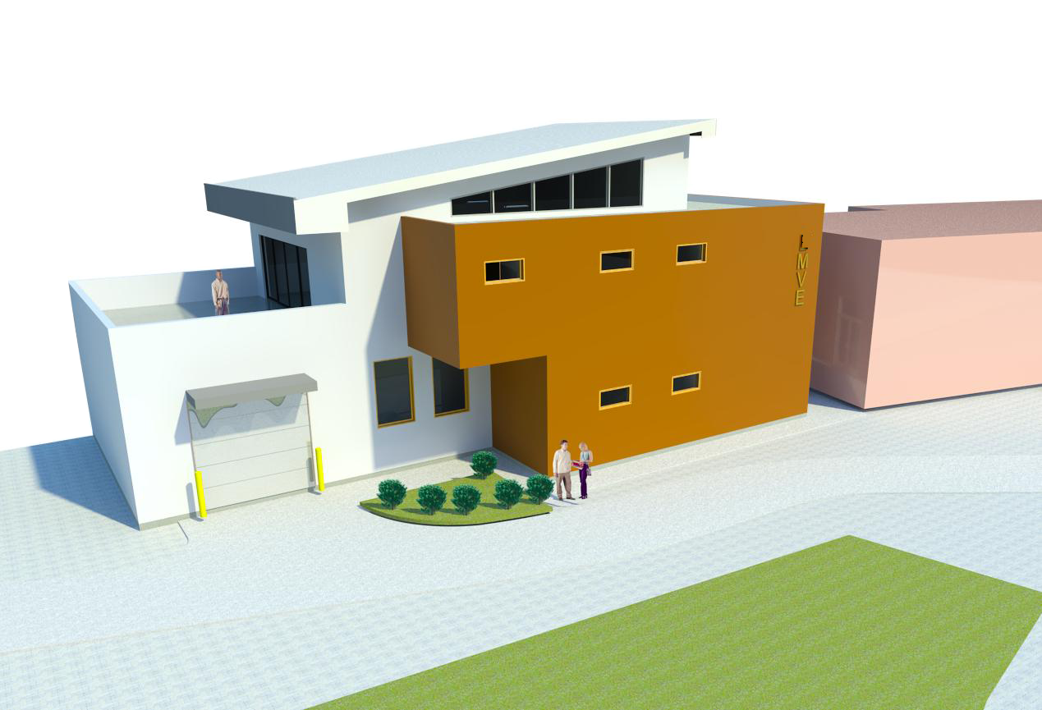
Thank You

Slide 15


